Slide 1
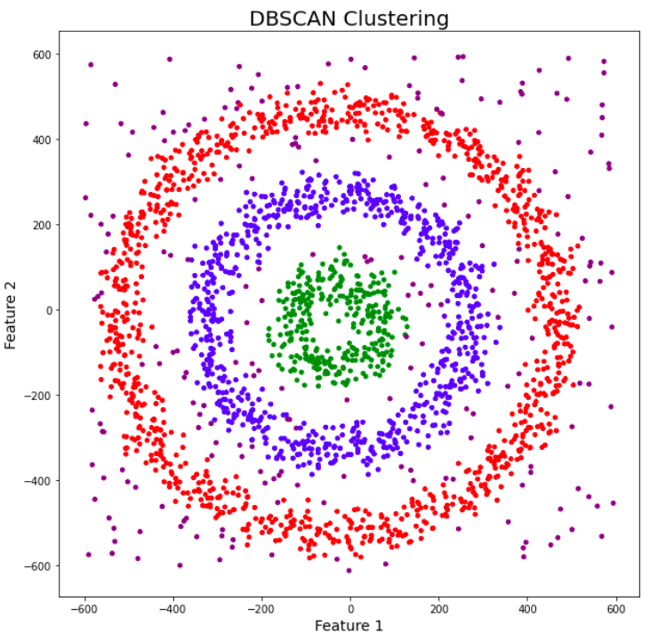
Density-Based Spatial Clustering of Applications with Noise (DBSCAN) is a base algorithm for density-based clustering. It can discover clusters of different shapes and sizes from a large amount of data, which is containing noise and outliers.

Slide 2
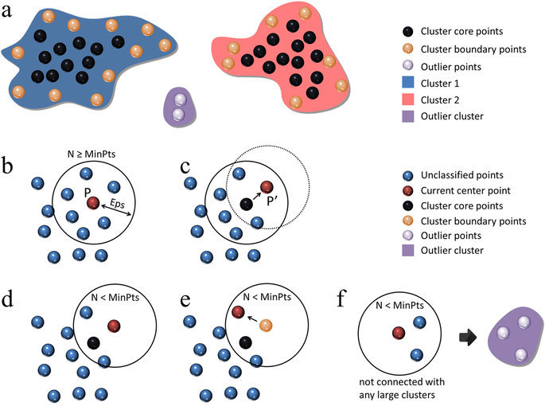
Illustration of how works

Slide 3
